Slide 1

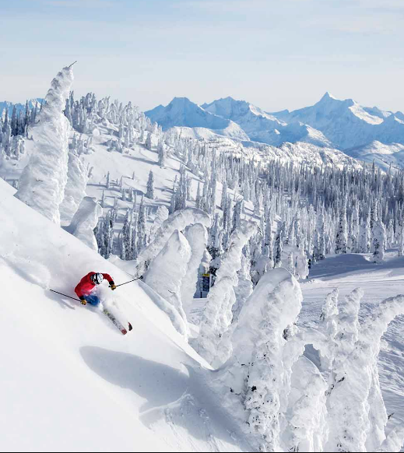
Big Mountain Resort: Price Modelling
Judah Drelich

Slide 2
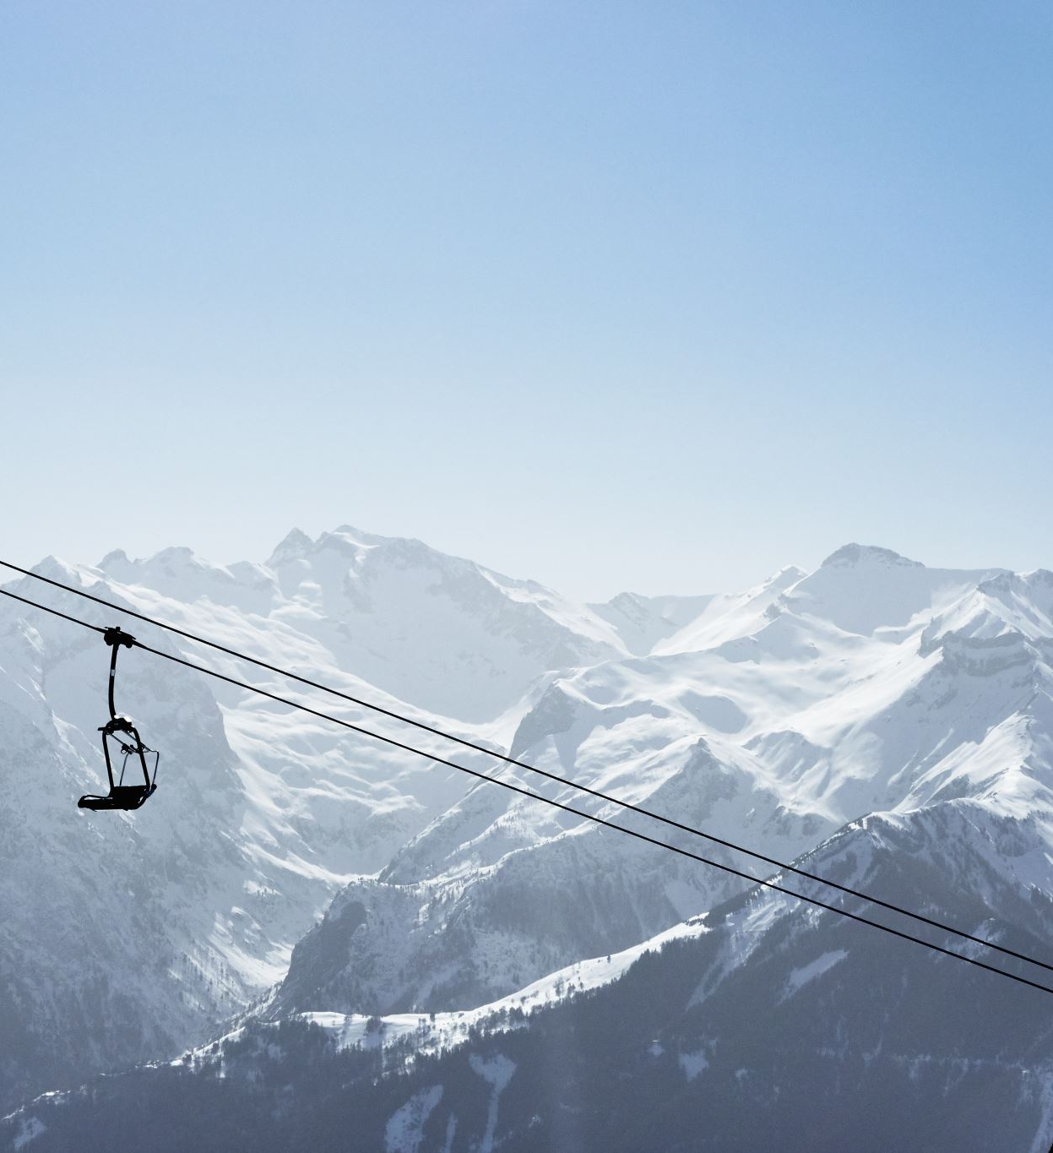
Problem Identification
Big Mountain Resort (BMR) wants to reevaluate its pricing relative to the market.
Big Mountain Resort recently installed a chairlift costing over $1.5 million.
The previous pricing strategy was to charge the average price for resorts in its market segment plus a premium.
BMR has many features but doesn’t have an easy way to understand how they affect the demand for a ticket.

Slide 3
Recommendation and key findings
BMR currently charges $81 per ticket.
Our modelling suggests that the market value of a BMR ticket based on the features that BMR offers is $95.87.
Even with a mean absolute error of $10.39, there is obvious reason to increase the price.
It is important to note that this model has a high degree of uncertainty; BMR should raise its prices but be careful not to raise them too high.

Slide 4

Modeling Results and Analysis
One idea that the data suggested is to add a ski run while increasing the vertical drop by 150 feet.
With this change, BMR could raise ticket prices by $1.99 and have an increase in revenue of $3,474,638.
Depending on the cost of a new run, that new feature would overcome the $1.5 million BMR invested into the chairlift.

Slide 5

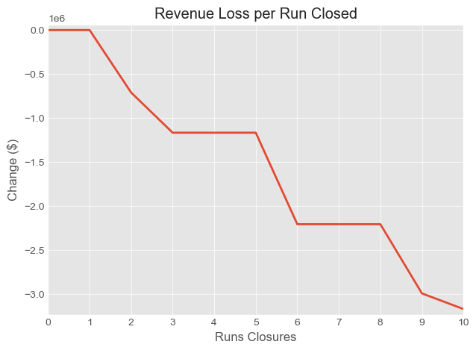
Modelling Results and Analysis Cont.
If BMR closes some of the ski runs to cut costs the savings could increase profits.
Cutting a single ski run will not affect the ticket price and would only decrease costs.
The graph on the right is a stair function,
The right number of closures can optimize savings without unnecessary loss to ticket revenue.

Slide 6
Shortcomings of the Data
There was a single dependent variable.
Without the ability to separate out the features and assess them on their own specific prices, there is more uncertainty in the conclusions of the model.
Two particularly important variables that were not in the dataset were:
GDP of surrounding area codes
Percent of out of state customers.
With these variables we would be able to know if we could charge a premium on top of the market rate that our model had determined.

Slide 7
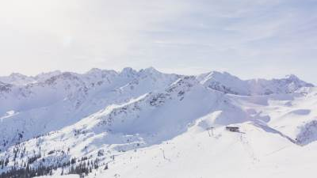
Summary and Conclusion
Big Mountain Resort should raise its prices to match the market.
BMR has some realistic ideas to raise revenue and cut costs.
Add a ski run and raise the drop in elevation by 150 feet
Close at least one run to cut costs.
This analysis process will help BMR in the future by putting into place a way to evaluate individual features impact on price.

